Slide 1
Development of a Text

Slide 2
Context

Slide 3
How does context help with understanding a text better?
Notes:
Context in writing is the setting or backdrop in which the story is written. The context definition in communication refers to the factors that work together to determine the meaning of a message.

Slide 4
What Happened Here?
Study the picture on the next slide for two minutes.
Think of three possible scenarios for this picture.
Answer the following questions:
Did you understand the photo as it is?
How did you come up with the reasons why this happened?

Slide 5
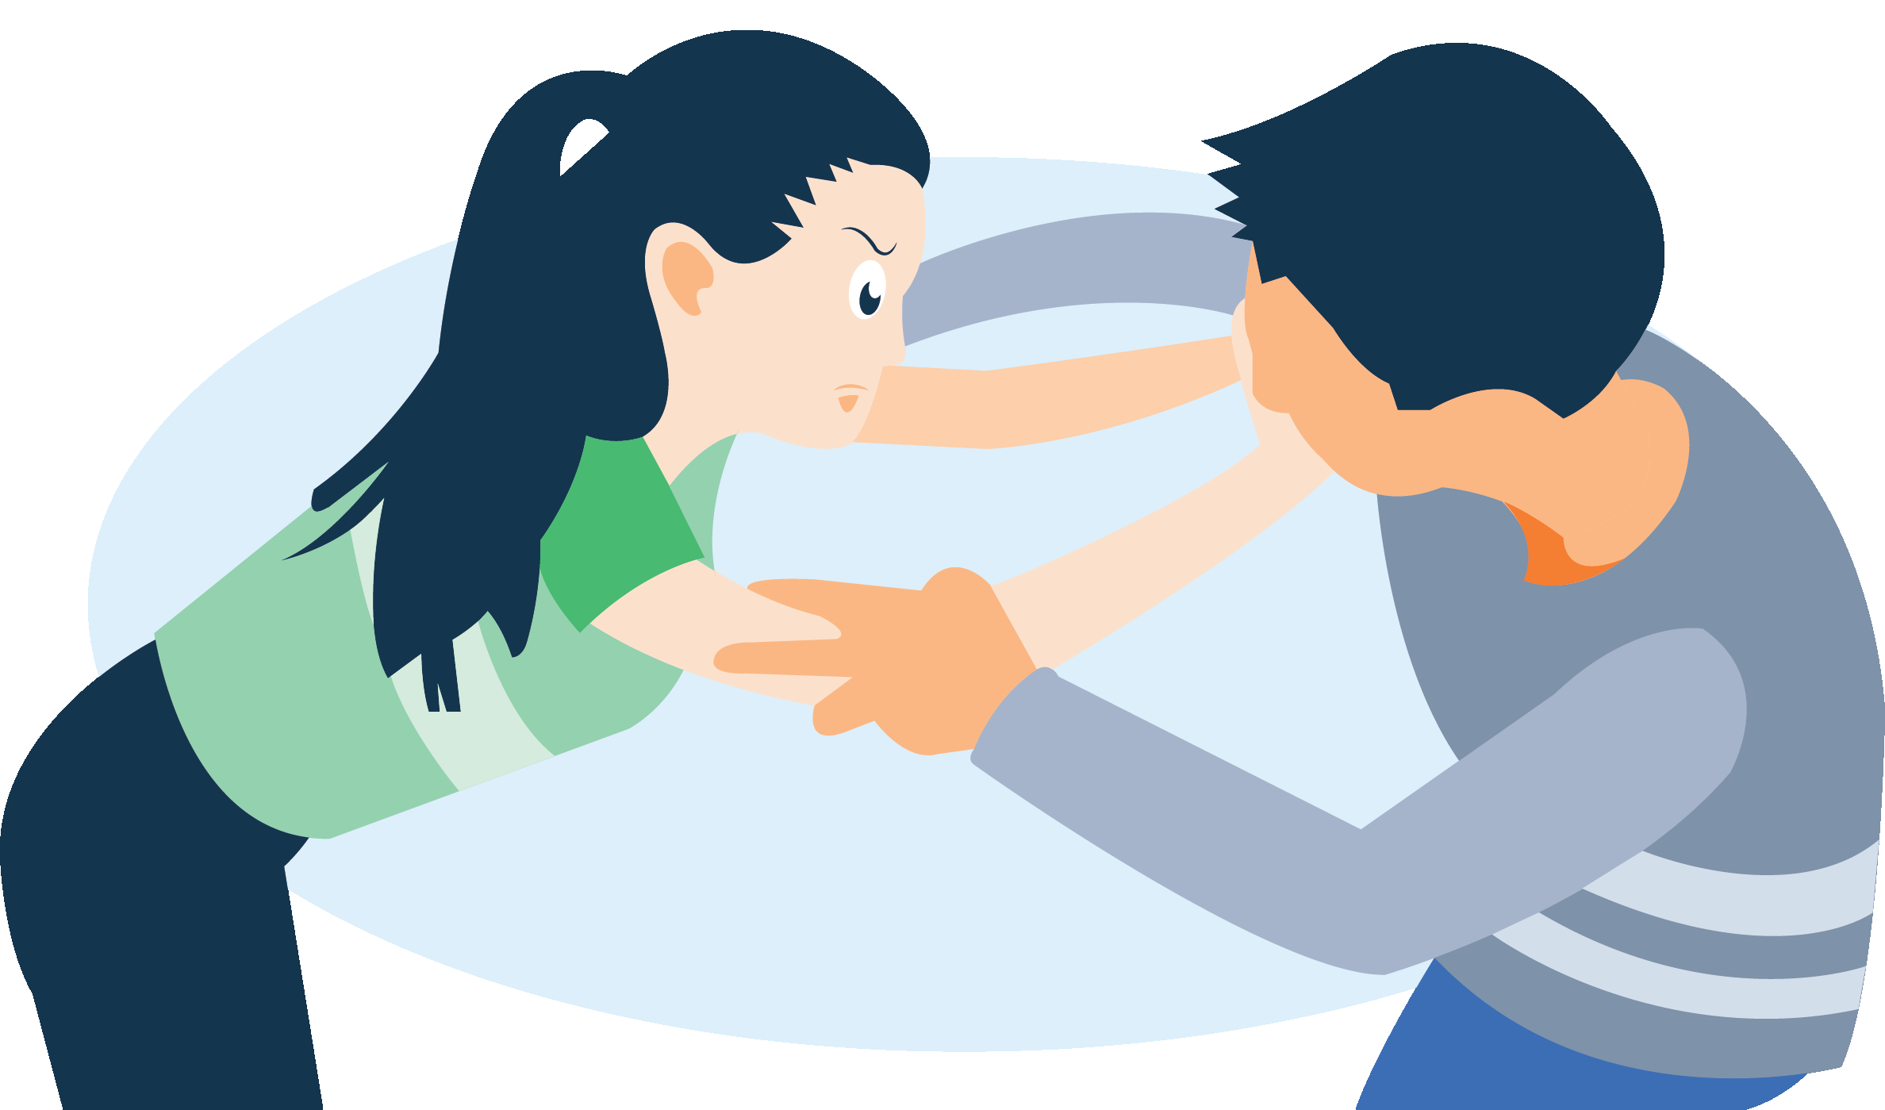

Slide 6
Context
It is the circumstances that give an idea about an event, statement, or written material so that it can be fully understood. Such circumstances, which can be cultural, historical, political, social, or economic events, shape or influence a writer in writing his or her work.

Slide 7
Components of Context
Subject - This is the main topic of the author’s work. It can be anything under the sun: culture, history, politics, society, economy, religion, current events, etc.

Slide 8
Components of Context
Purpose - This is the author’s reason for writing. It can be one of the following:
To narrate a story
To compare and contrast ideas
To review or evaluate a work
To explain an idea or concept
To explore and investigate an issue
To argue a point
To persuade the audience

Slide 9
Components of Context
Audience - The tone, style, diction, organization, and content of the author’s work depend on his or her target audience or readers.
Notes:
Tone in writing is the attitude your words employ.

Slide 10
Components of Context
Occasion or Situation - This may compel the writer to write, especially if it is significant or relevant to him or her personally. It can be his or her personal motivation to choose what to write about and how to write it.

Slide 11
Planning on Ride-Booking a Car?
Here are 3 Things You Should Know

Slide 12
Discuss the following questions after reading the text.
What is the subject of the text?
What can be an alternative title to the text based on the main idea gathered?
What was the author’s purpose? Justify your answer with textual evidence.
What could have influenced the author to write the text?
Are the ideas in the text relevant to and appropriate in the Philippine setting, particularly in urban areas? Justify your answer.

Slide 13
Intertextuality

Slide 14
Intertextuality
It is the relationship formed between two texts.
For a reader to understand the meaning of a text, he or she should be able to make sense of its connection or relationship with the other texts.

Slide 15
Intertextuality
Questions to ask:
Why did the author reference another text in his or her writing?
How is the text incorporated into the author’s writing? How did the author reimagine it?
What effect does the text have on the author’s writing?

Slide 16
Forms of Intertextuality
The writer references either a brief or prolonged portion of a literary text in his or her writing.

Slide 17
The references in The Lord of the Flies are loosely adapted from Treasure Island. The setting and the storyline of the two stories are similar. Both are adventures on stranded islands. However, the difference between the two is that William Golding, the author of The Lord of the Flies, creates a story about how adventure for young boys can be dangerous, while Robert Louis Stevenson’s Treasure Island romanticizes the notion that adventure can be fun.

Slide 18
Forms of Intertextuality
The writer references a media or social text in his or her writing.

Slide 19
Shrek is a prominent example of how the screenwriter was able to reference various kinds of media in the movie. The movie constantly references fairy tales as depicted in films, such as the Disney princesses. Because Shrek is considered part of the fantasy genre, the scriptwriters were also able to incorporate mini-stories from the different characters from the different fairy tales.

Slide 20
There is one scene wherein the princesses were actually an integral part of the plot, and they were mentioned by name.

Slide 21
The Hypertext

Slide 22
The Hypertext
It is an arrangement of information in a computer database, in which objects like text, pictures, and programs are linked to one another.
In reading an online article, for instance, the user can click on highlighted words or phrases (called hypertext links) to go to new Web pages with related content.

Slide 23
Intertextuality
Reading has ceased to become linear: by simply clicking on hypertext links, the reader is led to “an endless series of imagined connections, from verbal associations to possible worlds.” Simply put, hypertext is
a nonlinear way of showing information in a text, and
a text that references, alludes to, or derives from another text, which is called the hypotext.

Slide 24
Example (Non-linear)
On any news website, a reader has access to different headlines. If he or she would like to read about world news, sports, or lifestyles, he or she will be redirected to another page once they click a link. If they decide to go back to the homepage to access another page, it is done by clicking another article on the current page.

Slide 25
Example (Hypotext)
A lot of movie adaptations can be considered as hypertext. One prominent example is the 1995 movie Clueless, which is a hypertext of Jane Austen’s Emma, the hypotext. Its transformation is when the movie has become a completely independent text from the novel, as it does not directly refer to Emma at all, but both are considered as classics in their respective genres of teenage film and actual classic work.

Slide 26
Big Task

Slide 27
Form a group of five members. You will be assigned one of each of the following continents:
Asia
North America
South America
Europe
Each group should research a famous personality from your assigned continent.

Slide 28
Write a fan letter to the personality you chose. Make sure that you highlight an important event in that person’s life that you find influential.
Below the fan letter, answer this question:
How did you adjust your writing to take into account the context of the author?

